Slide 1

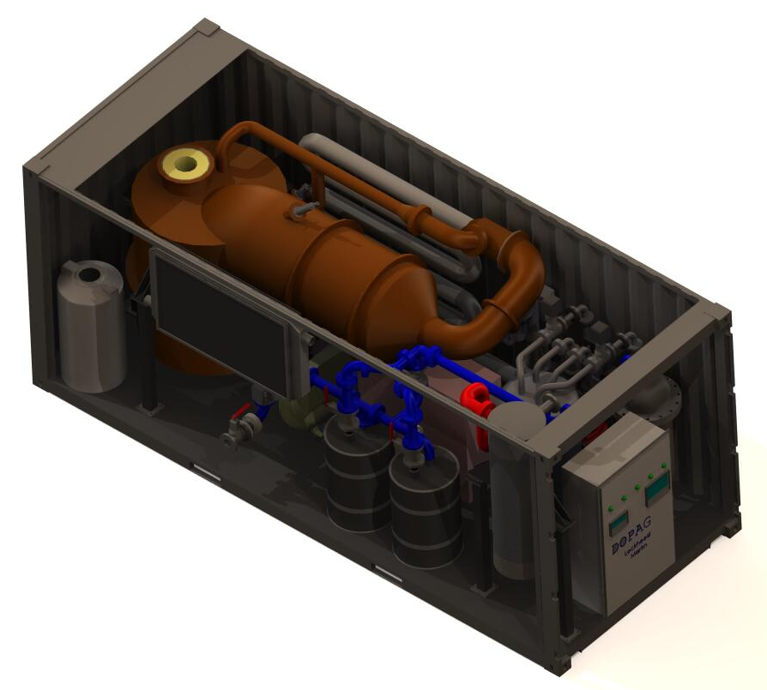
Logo helpful here
ACME Company, Inc​
12306 Maple Drive, Anytown, Ohio 33626​
POC: Charlie Brown, Director of Renewable Energy​
Phone: (609)760-2999 W, (123)456-7890 M​
Email: CharlieBrown@yahoo.com
Flexible Feedstock Waste-to-Energy Conversion System
(Descriptive
graphic here
is helpful)
This technology assists in minimizing the
waste stream while simultaneously
offsetting the cost by producing a
combustible gas that can be utilized to
generate electricity and heat.
Power and Energy
Energy
Installation Resilience
Deployable, self-contained, self-operated waste processing
Net Producer of energy in form of syngas, electricity, or heat
Eliminates hazardous materials, food/medical waste, and sewage
20 ft ISO container configuration for portability
Significant reduction in waste stream logistics and cost
Reduction in base operation planning and cost
Reduced footprint size
Environmentally friendly
100% Feedstock flexible
No Waste sorting necessary
Non-hazardous by-products
Produces clean syngas in volumes dependent upon waste stream
Net producer of energy
Kills pathogens and renders hazardous material inert, including hospital waste
20 ft ISO container configuration
Each container removes 3.3 tons of waste per day
Systems can be bundled to increase capability
Demonstrated to safely process solid wastes and hazardous wastes including red bag hospital waste
Demonstrated on a small municipal scale at Carver, Alabama with 3rd party validation of performance by Tuskegee University
Acme has experience developing container systems for other applications including removal of oil and heavy metals from soil.
8
Demonstrated on a small municipal scale
SCALING CONSIDERATIONS:
Proven containerized, self-operating system can be scaled for large municipal systems, or operated as multiple stand-alone units
Electrical outputs of multiple units can be linked for greater capacity
Individual units ~$500k, with a 10 year service life
TIME TO MARKET WITH CURRENT FINANCIAL PLANS:
Current Inventory of 10 on hand, production of 1 per month.
TIME TO MARKET WITH FINANCIAL ASSISTANCE:
With $1M additional funding, able to ramp to 10 per month in 3 mos.
.

