Slide 1
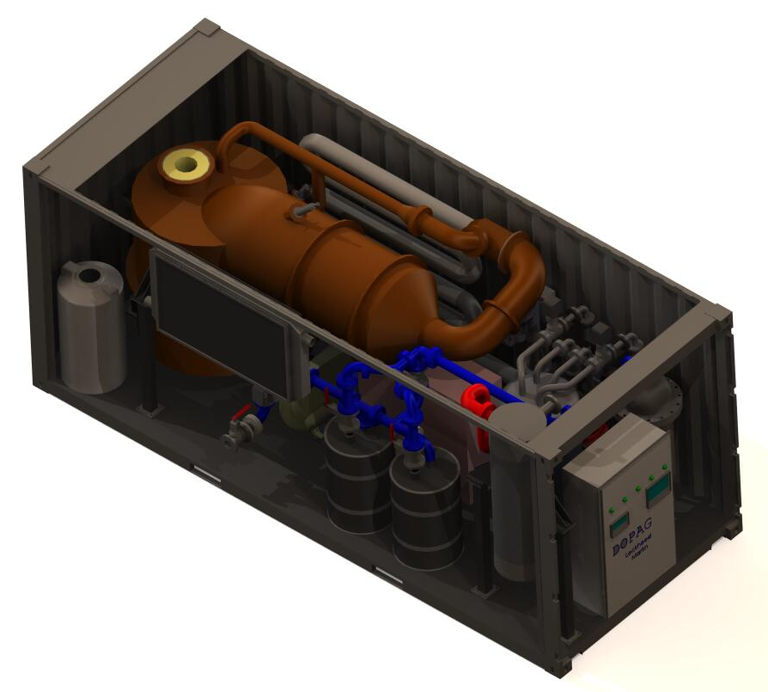
Flexible Feedstock Waste-to-Energy Conversion System
SBDC Logo from Your home state or the one assisting you
Company Name: Bill Carey www.yourwebsite.com
Bottom Line Up Front (BLUF)
Relevance to DoD
Category:
DIU Area Focus: Energy
DIU Line of Effort: Installation Resilience
Maturity / Scalability
Past Performance of Technology and Company
This technology assists in minimizing the waste stream while simultaneously offsetting the cost by producing a combustible gas. A pyrolysis method is incorporated with additional features to process a flexible waste stream, which can include hazardous and medical waste without sorting. All pathogens are eliminated, and any associated hazardous materials are rendered inert. The result is a non-hazardous by-product and a clean syngas, which can be utilized directly, or further processed within the system to generate electricity and heat. This technology is at a Technology Readiness level 8 and addresses the DoD requirements need for Waste to Energy.
Power and Energy
SCALING CONSIDERATIONS:
Proven containerized, self-operating system can be scaled for large municipal systems, or operated as multiple stand-alone units
Electrical outputs of multiple units can be linked for greater capacity
Individual units ~$500k, with a 10-year service life
Status of the technology, demonstrations, special features
Some info about the company’s background to help communicate its capabilities and that it is stable and capable of developing to full product innovation.
Deployable, self-contained, self-operated waste processing
Net Producer of energy in form of syngas, electricity, or heat
Eliminates hazardous materials, food/medical waste, and sewage
20 ft ISO container configuration for portability
Significant reduction in waste stream logistics and cost
Reduction in base operation planning and cost
Reduced footprint size
Environmentally friendly
Technology Readiness Level =
8
Photo revealing Technologies
Demonstrated on a small municipal scale
Photo demonstrating Scale
DoD Centric Photo for Relevance
About the Company
Technology / Capability Overview
Time & Cost to Market
Describe your team and mention some expertise/backgrounds, accomplishment statements. Company mission, etc. can be included here.
This technology assists in minimizing the
waste stream while simultaneously
offsetting the cost by producing a
combustible gas that can be utilized to
generate electricity and heat.
100% Feedstock flexible
No Waste sorting necessary
Non-hazardous by-products
Produces clean syngas in volumes dependent upon waste stream
Net producer of energy
Kills pathogens and renders hazardous material inert, including hospital waste
Time to Market With Current Financial Plans:
Currently, inventory of 10 on hand, production of 1 per month.
Market Significance
Describe your potential market, any proof of market validation, testimonials from current or potential customers, especially Primes or other Government Agencies (for DoD purposes)
Time With Additional Financial Assistance:
Acknowledgments
With $1M Additional Funding able to ramp production to 10 per month in 3 months.
Use this space if desired or delete it and use the extra space for the categories above. Acknowledge your program, any funding awards, important people (most significantly, DoD personnel), or any other type of support you received. Place relevant Awards that will draw significance or companies or government agencies you are presently serving.

